Slide 1
Match Five!
Example question

Slide 2
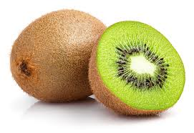
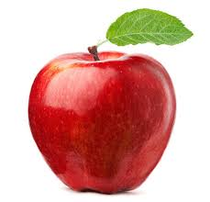
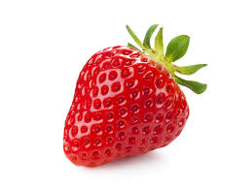
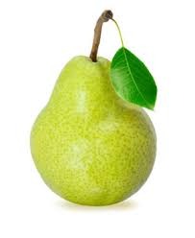
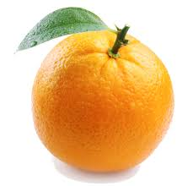
Match the image to the word or phrase
1 Apple
2 Kiwi
3 Orange
4 Pear
5 Strawberry
A
B
C
D
E

Slide 3
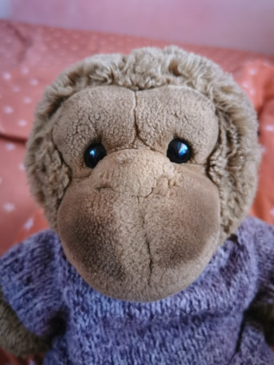
Match the image to the word or phrase
1 Apple
2 Kiwi
3 Orange
4 Pear
5 Strawberry
A
B
I’m a Great Ape
Question 1
C
1 B
2 A
3 E
4 D
5 C
D
E
All correct, 2 points!

Slide 4
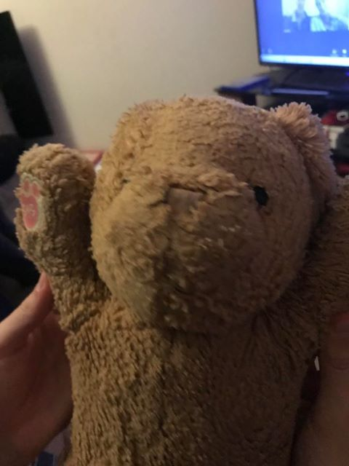
Match the image to the word or phrase
1 Apple
2 Kiwi
3 Orange
4 Pear
5 Strawberry
A
B
What?
Question 1
C
1 A
2 B
3 E
4 D
5 C
D
E
Two wrong, 1 point!

Slide 5
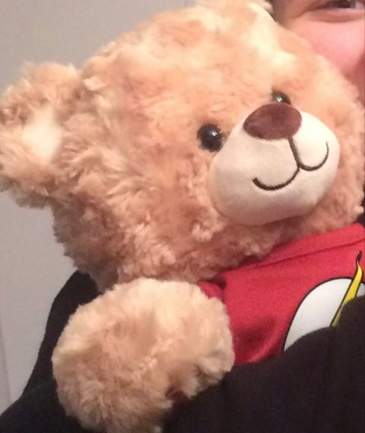
Match the image to the word or phrase
1 Apple
2 Kiwi
3 Orange
4 Pear
5 Strawberry
A
B
Oh dear…
Question 1
C
1 B
2 A
3 C
4 E
5 D
D
E
Three wrong, no points.
Oh dear!

